Slide 1








SES MDI using SDC/SDPi+FHIR Framework & Considerations
Pre-release
Draft 2020.09.18
ADD UML MODEL
UPDATE Gardens \Diagram
Establishing a framework for
Trusted Interoperable Product Decoupling
FHIR is a trademark of Health Level 7, International.
SDC is a registered trademark of OR.NET

Slide 2
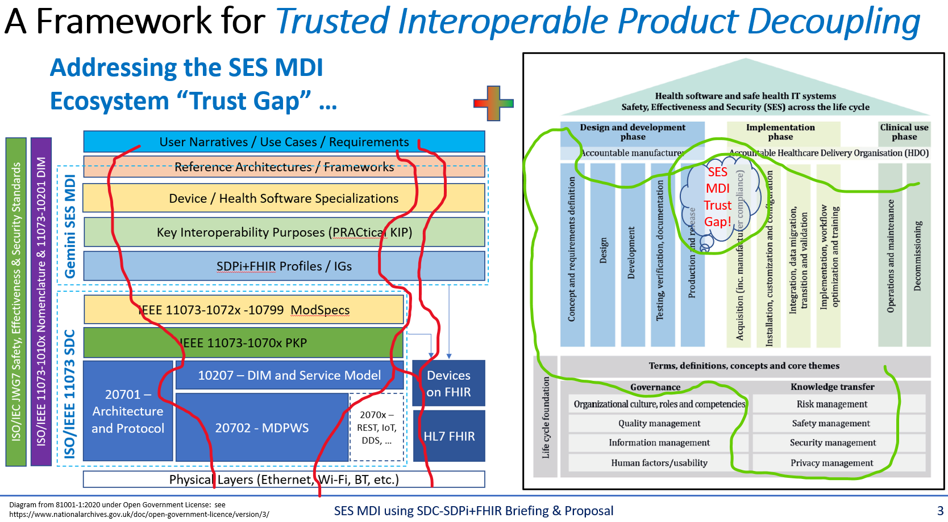
SES MDI Using SDC/SDPi+FHIR – The Big Idea
Full presentation available @ Gemini SDPi+FHIR “The SES MDI Interoperability Trust Gap” @ https://confluence.hl7.org/x/IQ7xB

Slide 3
Questions to Contemplate …
How to minimize duplication of information & effort?
How to maximize use of work and resources already created?
What is the requirements starting point & ending point?
How to truly integrate SES & MDI … seamlessly?!
How to craft a framework for SES “PnT” MDI …
… With an achievable starting point & compelling future state?

Slide 4
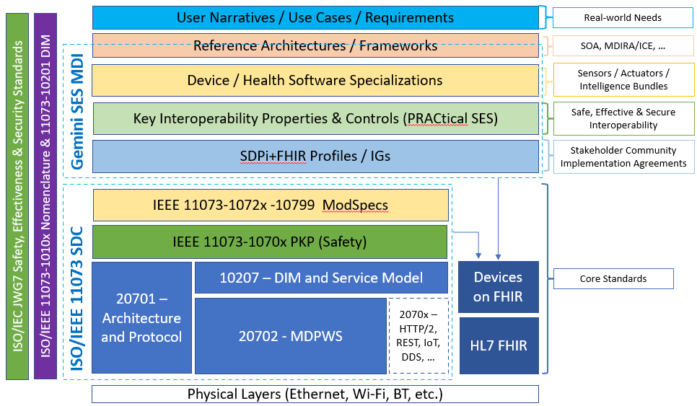
SES MDI Using SDC/SDPi+FHIR – The Big Picture
“Hanging Gardens” Model
Perfect? Not!
Useful? Absolutely!!!
Provides a common reference point to consider the questions and identify a workable framework
Cuts across …
Standards
Organizations
Subject Areas
Past/Present/Future
….

Slide 5
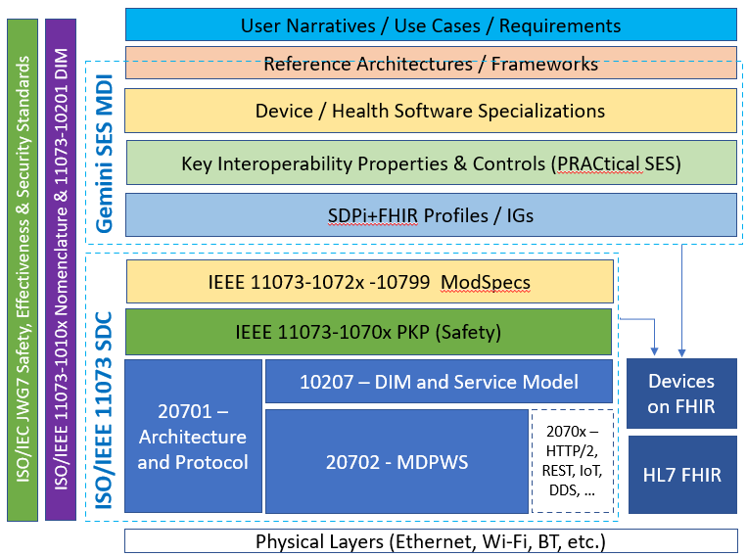
“Hanging Gardens” Model – Layer Integration
Each layer can be characterized by:
Unique Subject Concepts & Components (Terms)
Layer-specific Information & Knowledge (UML models)
Layer API & Capabilities & Requirements (Inter-layer Spec’s)
Requirements Formalization (Gherkin & ReqIF Spec’s)
Implementation Trust Logic (SES Assurance Case Spec’s)
Implementation Technology Logic (MDI Spec’s)
Integrating each “hanging garden” can be achieved by “threading” …
horizontally – across layer-specific characterization dimensions
+
vertically – mapping from scenarios to Plug-and-Trust decoupled product interfaces

Slide 6
Layer Characterization: Horizontal & Vertical
Horizontal
(Intra-Garden Walkways)
Vertical
(Inter-Garden Stairways)
Unique Subject Concepts & Components (Terms)
Each Layer Characterized Horizontally
&
Integrated Vertically
Layer-specific Information & Knowledge (UML models)
Layer API & Capabilities & Requirements (Inter-layer Spec’s)
Requirements Formalization (Gherkin & ReqIF Spec’s)
Implementation Trust Logic (SES Assurance Case Spec’s)
Implementation Technology Logic (MDI Spec’s)

Slide 7
Garden Design: Horizontal Integration
Unique Subject Concepts & Components (Semantics/Terms)
Concepts, terms, definitions, algorithms, frameworks, …
Layer-specific Information & Knowledge (UML models)
Use Case / Activity Diagrams, Sequence Models, Object Models, etc.
Layer API & Capabilities & Requirements (Inter-layer Spec’s)
“API” Specifications, Implementation “Platform” Requirements, etc.
INCLUDE MAPPING COMPONENT / ARTIFACTS + standards in scope
Create a UML model showing relationships
Requirements Formalization (Gherkin & ReqIF Spec’s)
Feature, Rule, Given/When/Then + Specification, SpecRelation (Source, Target), etc.
Implementation Trust Logic (SES Assurance Case Spec’s)
Profiled application of 81001-1, 80001-1, 62304, assurance cases, etc.
Implementation Technology Logic (MDI Spec’s)
System Actors, Transactions, Messages, Events, Terminology, Value Sets, etc.

Slide 8
Garden Design: Requirements Management
Requirements Formalization (Gherkin & ReqIF Spec’s)
Feature, Rule, Given/When/Then + Specification, SpecRelation (Source, Target), etc.
INCLUDE:
ReqIF UML Profile (for SDPi)
Gherkin (per spec link, UML profile (for SDPi), Art’s briefing, etc.)
@ Use Case Layer Only?
PKP Example (see pic)
Tooling? (“ReqIF Studio” tool? “Eclipse ProR”)

Slide 9
Garden Design: Vertical Integration
Unique Subject Concepts & Components (Semantics/Terms)
Concepts, terms, definitions, algorithms, frameworks, …
Layer-specific Information & Knowledge (UML models)
Use Case / Activity Diagrams, Sequence Models, Object Models, etc.
Layer API & Capabilities & Requirements (Inter-layer Spec’s)
“API” Specifications, Implementation “Platform” Requirements, etc.
Use Case(s) to SOA to DS to KIP(SES) to SDPi to SDC to SFC
Requirements Formalization (Gherkin & ReqIF Spec’s)
Feature, Rule, Given/When/Then + Specification, SpecRelation (Source, Target), etc.
Implementation Trust Logic (SES Assurance Case Spec’s)
Profiled application of 81001-1, 80001-1, 62304, assurance cases, etc.
Implementation Technology Logic (MDI Spec’s)
System Actors, Transactions, Messages, Events, Terminology, Value Sets, etc.

Slide 10
Layer Characterization: Horizontal & Vertical Model
CREATE A UML MODEL SHOWING ALL THE BITS THAT GET INTEGRATED HORIZONTALLY & VERTICALLY
Horizontal
(Intra-Garden Walkways)
Vertical
(Inter-Garden Stairways)
Unique Subject Concepts & Components (Terms)
Each Layer Characterized Horizontally
&
Integrated Vertically
Layer-specific Information & Knowledge (UML models)
Layer API & Capabilities & Requirements (Inter-layer Spec’s)
Requirements Formalization (Gherkin & ReqIF Spec’s)
Implementation Trust Logic (SES Assurance Case Spec’s)
Implementation Technology Logic (MDI Spec’s)

Slide 11
Garden: Use Case Scenarios
Unique Subject Concepts & Components (Terms)
Narrative Stories, Actors (People & Systems), Scenarios, Activities, …
Layer-specific Information & Knowledge (UML models)
Use Case / Activity Diagrams, Sequence Models, Object Models, etc.
Layer API & Capabilities & Requirements (Inter-layer Spec’s)
“API” Specifications, Implementation “Platform” Requirements, etc.
Update layout to focus on Use Case Stuff – Minimize horizontal / vertical
Add layer Scope / Garden Theme
Requirements Formalization (Gherkin & ReqIF Spec’s)
Feature, Rule, Given/When/Then + Specification, SpecRelation (Source, Target), etc.
Implementation Trust Logic (SES Assurance Case Spec’s)
, etc.
Implementation Technology Logic (MDI Spec’s)
Actors, Transactions, Messages, Events, Terminology, Value Sets, etc.

Slide 12
Garden: Reference Architectures
Architecture layer
Include: MDIRA/ICE and SDC/SOA examples

Slide 13
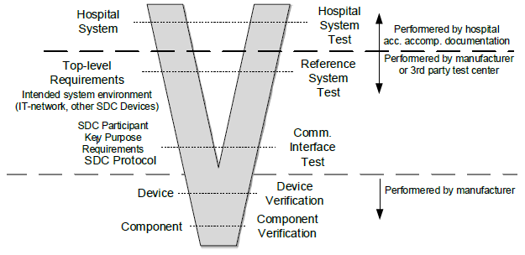
Garden: Key Interoperability Purposes (SES)
SES KIP
Includes:
SES profiles @ MDI standards
Assurance Case Templates
Interoperability model(s)
4 Key Purpose Areas for MDI
Profiles for applying SES standards to SDC/SDPi+FHIR (incl. 81001-1, 80001-1. 82304, 62304, etc.)
INCLUDE 81001-1 / 80001-1 REQUIREMENTs that are aligned with LIFECYCLE PHASES including RIGHT SIDE STAKEHOLDERS and filling in “open” requirements => provisioned to device (via PKI?) and including arch requirements etc. [baseline PnT + “value added” for enhanced SES] *** Usability of Device Coupling Strategies, PnT, …
SFC spec includes SES requirements that COULD / MUST be completed in the Deployment RM … + how formalized in the PKI/EKU provisioned at implementation?

Slide 14
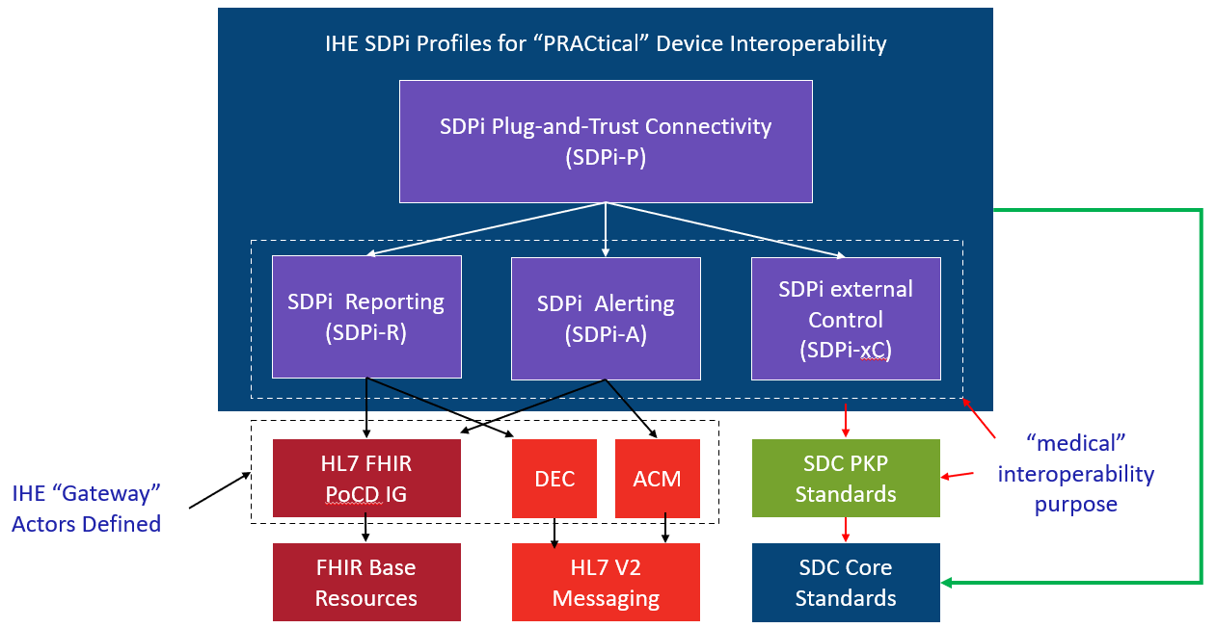
Garden: IHE SDPi
IHE SDPi
IHE TF Constructs:
Use Cases (actors, transactions

Slide 15
Garden: ISO/IEEE 11073 SDC
SDC – ModSpecs, PKP, BICEPS, SOMDA, MDPWS
<? 5 slides or one or … ???>
<include mapping to TF volumes>
Integrated Rxxxx
BICEPS model
SOMDA Model
WS-*

Slide 16
Hanging Gardens: Pulling it all together …
SES MDI (TF-1 Appendix A)
SFC – Specification / formalization / organization / …
Assurance Cases – composable / computable / V&V’able / CA’able
SES Requirements – per 81001-1, 80001-1, 60601-x-y, 62304, etc.
KIP(Regulatory) – sans implementation tech (see earlier slide)
CA @ SFC …
ACID TEST:
Requirement Test: Verify that PKP OID is in a device’s security certificate
Challenge: Do we know WHY it has to be there? Can we trace that requirement to the initial layer (Scenario?) that mandated its inclusion?

Slide 17
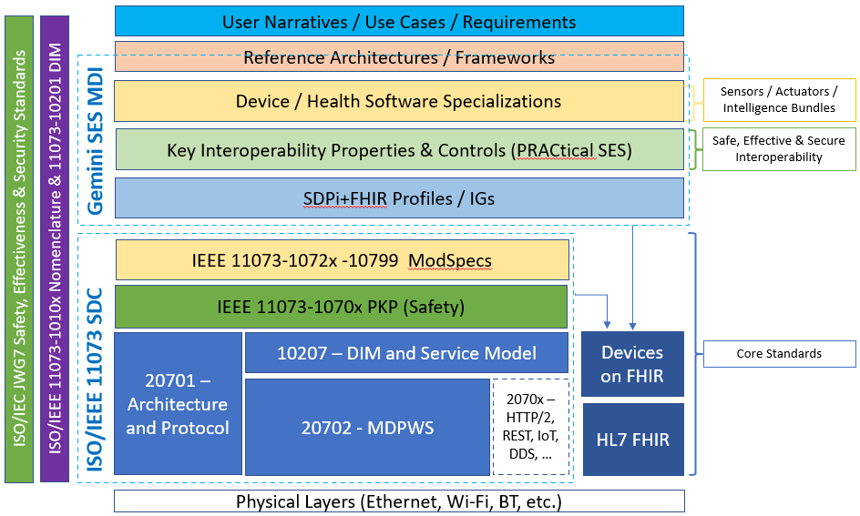
Hanging Gardens: After SDPi 1.0 …
NOTE: Profile Titles are notional – hopefully useful too!
Devices-In-Care (PDP) Profile
Device Specialization Profile
Surgery PoC Profile
ICU PoC Profile
MDIRA ICE Profile
SOMDS@home Profile
IHE (Official) Profile Types:
Transport, Content, Workflow
Or a combination of all (3)
Other types?
Architecture (SOA, MDIRA, SDC, ….?
Single domain / multi-domain?

Slide 18
SDC/SDPi-Based Profiles: MDIRA/ICE Profile
NOTE: Profile Titles are notional – hopefully useful too!
Devices-In-Care (PDP) Profile
Device Specialization Profile
Surgery PoC Profile
ICU PoC Profile
MDIRA ICE Profile
SOMDS@home Profile
IHE (Official) Profile Types:
Transport, Content, Workflow
Or a combination of all (3)
Other types?
Architecture (SOA, MDIRA, SDC, ….?
Single domain / multi-domain?

Slide 19
SDC/SDPi-Based Profiles: Surgery Profile
NOTE: Profile Titles are notional – hopefully useful too!
Devices-In-Care (PDP) Profile
Device Specialization Profile
Surgery PoC Profile
ICU PoC Profile
MDIRA ICE Profile
SOMDS@home Profile
IHE (Official) Profile Types:
Transport, Content, Workflow
Or a combination of all (3)
Other types?
Architecture (SOA, MDIRA, SDC, ….?
Single domain / multi-domain?

Slide 20
SDC/SDPi-Based Profiles: ICU Profile
NOTE: Profile Titles are notional – hopefully useful too!
Devices-In-Care (PDP) Profile
Device Specialization Profile
Surgery PoC Profile
ICU PoC Profile
MDIRA ICE Profile
SOMDS@home Profile
IHE (Official) Profile Types:
Transport, Content, Workflow
Or a combination of all (3)
Other types?
Architecture (SOA, MDIRA, SDC, ….?
Single domain / multi-domain?

Slide 21
… speaking about
Test Tooling …

Slide 22
SDC / SDPi Test Tooling
<include white paper tooling diagrams>
<tool chain from requirements analysis to CA>
<maps & gaps – e.g., ReqIF>
<Use of NIST / Abestos, …>
<…>
<…>

Slide 23
Additional
Information

Slide 24
OMG Requirements Interchange Format (ReqIF) “Mapping”
Background

Slide 25
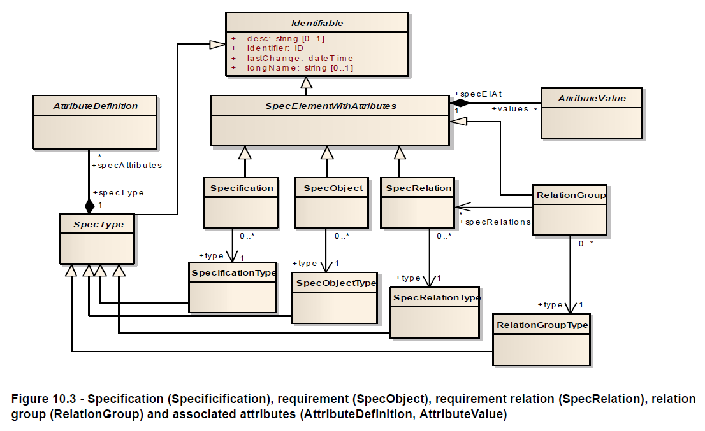
OMG ReqIF: Base Model

Slide 26
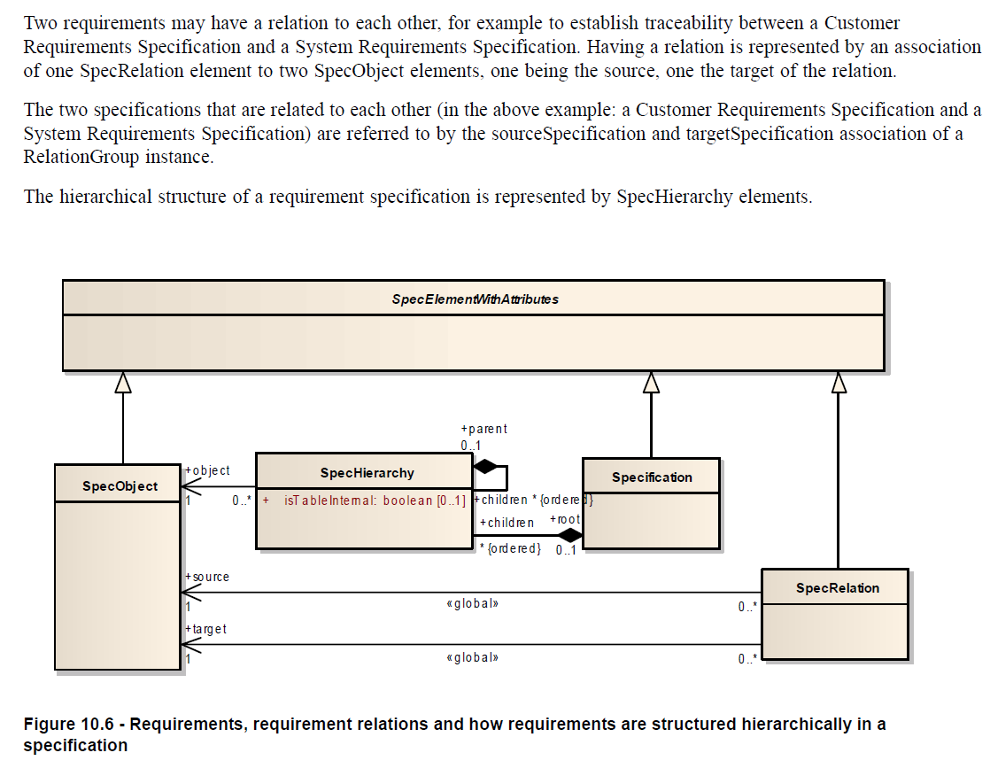
ReqIF: Requirement Hierarchies & Relationships
“mapping” between
Source & Target Requirements

